Slide 1
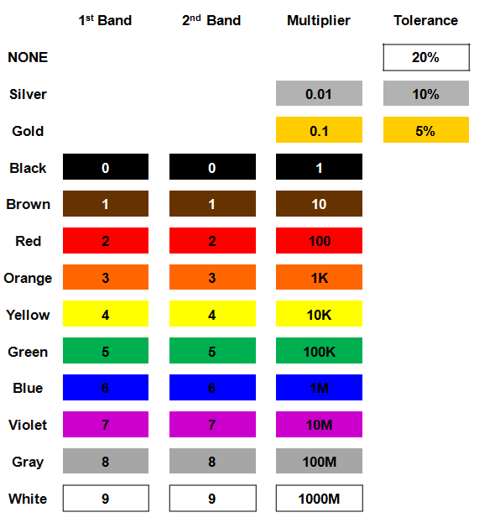
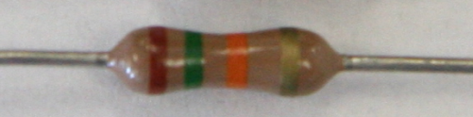
Resistor Value: Example #3
Example:
Determine the color bands for a 1.5 K Ω ±5% resistor.
?
?
?
?
Solution:
1.5 K Ω ±5%
1500 Ω ±5%
15 x 100 Ω ±5%
1: Brown
5: Green
100: Red
5%: Gold
Notes:
This slide includes the solution to Resistor Value Example #3. If you print handouts, do not print this page.

